Slide 1
Classic Nintendo Games are (Computationally) Hard
By Yifang Zhang

Slide 2
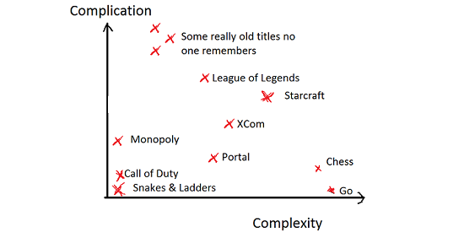
Background & History of Game Complexity Proofing
Definitions - Computational complexity of a game
“Describes the asymptotic difficulty of a game as it grows arbitrarily large, expressed in big O notation or as membership in a complexity class” (wiki)
Not for particular gameplay, but in a generalized form
Some complete problems we know:
  Tic-Tac-Toe (10x10) is P
  Starting from Tic-Tac-Toe (nxn) is PSPACE-complete
  Chess: EXP-complete without 50-move drawing rule
  Go: EXP-complete
Notes:
Speaker’s notes:
“Describes the asymptotic difficulty of a game as it grows arbitrarily large, expressed in big O notation or as membership in a complexity class” from wikipedia
The game is not any particular gameplay, etc. it will be meaningless for us to prove Super Mario Bros (SMB) gameplay is NP-hard, because we all know that we have people who can pass all levels in days, that is pretty much proved the answer. But now we are looking at the generalized form, which is like we are in edition mode and be able to use all tools what designer of the game provided to us. In other words, we can design for all levels and still consider the SMB is a NP-hard.

Slide 3
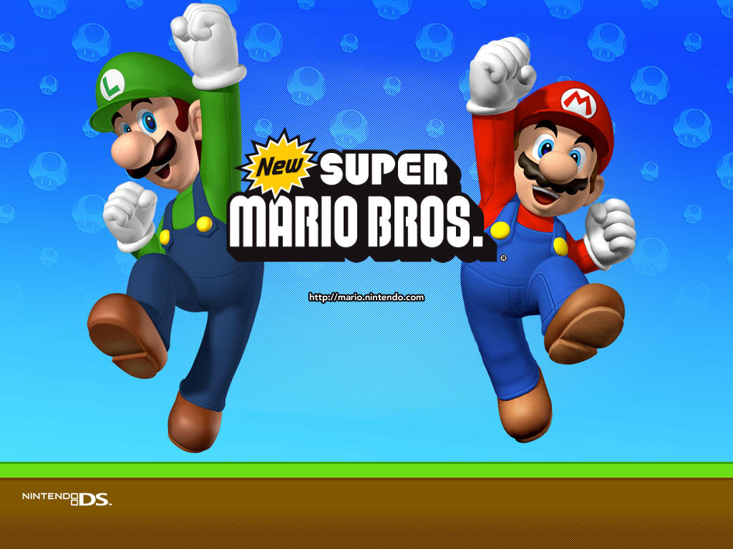

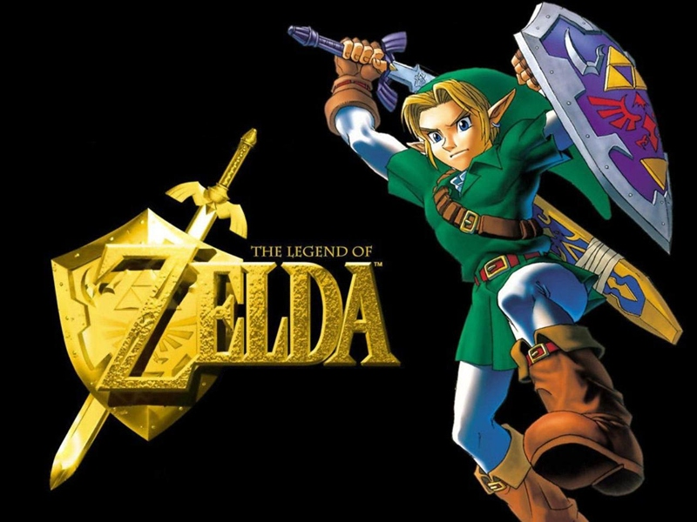

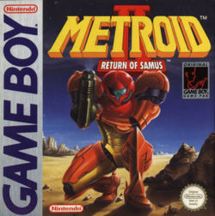
Classic Nintendo Games
Super Mario Bros (SMB)
Pokemon
Legend of Zelda
Donkey Kong
Metroid

Slide 4
Generalization & Proof
Generalize the game into NP Model
  Also available for PSPACE and EXPSPACE (currently stage)
For All Games in Nintendo:
  They are generally PSPACE bounded
For NP Proof:
  Game → Build 3-SAT model by Game element → Mapping on Generalized 3-SAT

Slide 5
Nintendo Games are Bounded by PSPACE
Proof:
Game element’s behavior is simple
Solve a level by making moves in NPSPACE
Apply NPSPACE = PSPACE
Level is polynomial, Game is in PSPACE
Notes:
Most of the games considered PSPACE:
Step 1: every game element’s behavior is simple (deterministic) function of the play’s moves.
Step 2: Solve a level by making moves nondeterministrically at current state
Step 3: applying NPSPACE = PSPACE
Step 4: Since the level of the game will be polynomial, the game will ended in PSPACE
Note 1: Legend of Zelda and its sequels will have enemy to have pseudorandomly, as long as we can encode those random seed in a polynomial number of bits, which will be reasonable (usually those are related to the number e) implementations.

Slide 6
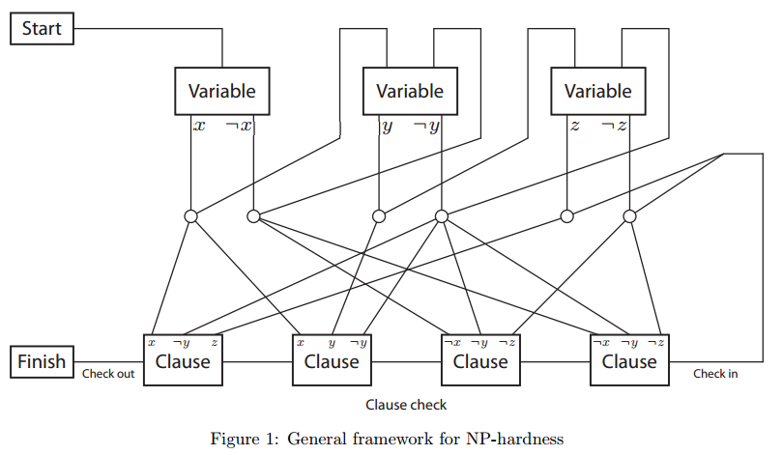
The Approach: NP-Hardness Framework
Notes:
With this framework in hand, we can prove hardness of individual games by just constructing the necessary gadgets.
Framework reduced from NP-complete to 3-SAT:
-- “Decide whether a 3-CNF Boolean formula can be made ‘true’ by setting the variable appropriately”
-- player start at Start Gadget
-- then pass through Variable Gadget, each will force the player to choose “true” or “false” (in graph it shows x and ~x). Each choices will leading player to follow the paths leading to the next Gadget
-- There will be Crossover Gadget during the paths, and it must be preventing the switching for players from crossing from one path to another, which is called leakage.
-- After traversed all Variable Gadgets, the player must traverse a long “check” path though each Clause Gadget, to reach Final Gadget.
-- The player can go through the check path iff each Clause Gadget has been unlocked by some literal
-- So for proving a game is NP-hard, we need to go to edition mode and create each of the states for this model in order to prove the game is NP-hard.
--

Slide 7
Remarks in NP-Hardness model
Crossover
Gadget
A
Notes:
-- Remark 2.1: Crossover gadget only needs to be unidirectional
-- Remark 2.2: It is safe to further assume in a Crossover gadget that each of the two crossing paths is traversed at most once, and that one path is never traversed before the other path (i.e., if both paths are traversed, the order of traversal is fixed). This is sufficient because two literal paths either are the two sides of the same Variable (and hence only one gets traversed), or they come from different Variables, in which case the one from the earlier Variable in the sequence is 4 guaranteed to be traversed before the other (if it gets traversed at all). Thus it is safe to have a Crossover gadget, featuring two crossing paths A and B, which after traversing path B allows leakage from A to B. (However, leakage from B to A must still be prevented.)

Slide 8
Remarks in NP-Hardness model
Crossover
Gadget
A
B
Notes:
-- Remark 2.1: Crossover gadget only needs to be unidirectional
-- Remark 2.2: It is safe to further assume in a Crossover gadget that each of the two crossing paths is traversed at most once, and that one path is never traversed before the other path (i.e., if both paths are traversed, the order of traversal is fixed). This is sufficient because two literal paths either are the two sides of the same Variable (and hence only one gets traversed), or they come from different Variables, in which case the one from the earlier Variable in the sequence is 4 guaranteed to be traversed before the other (if it gets traversed at all). Thus it is safe to have a Crossover gadget, featuring two crossing paths A and B, which after traversing path B allows leakage from A to B. (However, leakage from B to A must still be prevented.)

Slide 9
Remarks in NP-Hardness model
Crossover
Gadget
A
Allowed
Not Allowed
B
Notes:
-- Remark 2.1: Crossover gadget only needs to be unidirectional
-- Remark 2.2: It is safe to further assume in a Crossover gadget that each of the two crossing paths is traversed at most once, and that one path is never traversed before the other path (i.e., if both paths are traversed, the order of traversal is fixed). This is sufficient because two literal paths either are the two sides of the same Variable (and hence only one gets traversed), or they come from different Variables, in which case the one from the earlier Variable in the sequence is 4 guaranteed to be traversed before the other (if it gets traversed at all). Thus it is safe to have a Crossover gadget, featuring two crossing paths A and B, which after traversing path B allows leakage from A to B. (However, leakage from B to A must still be prevented.)

Slide 10
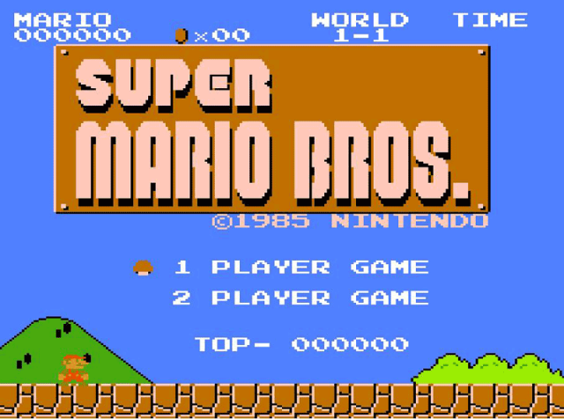
Proof for SMB (Super Mario Bros.)

Slide 11
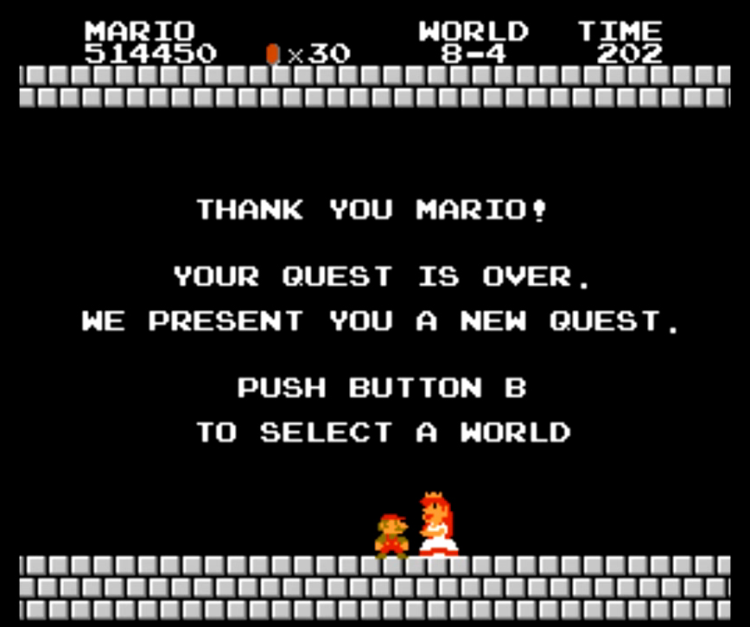
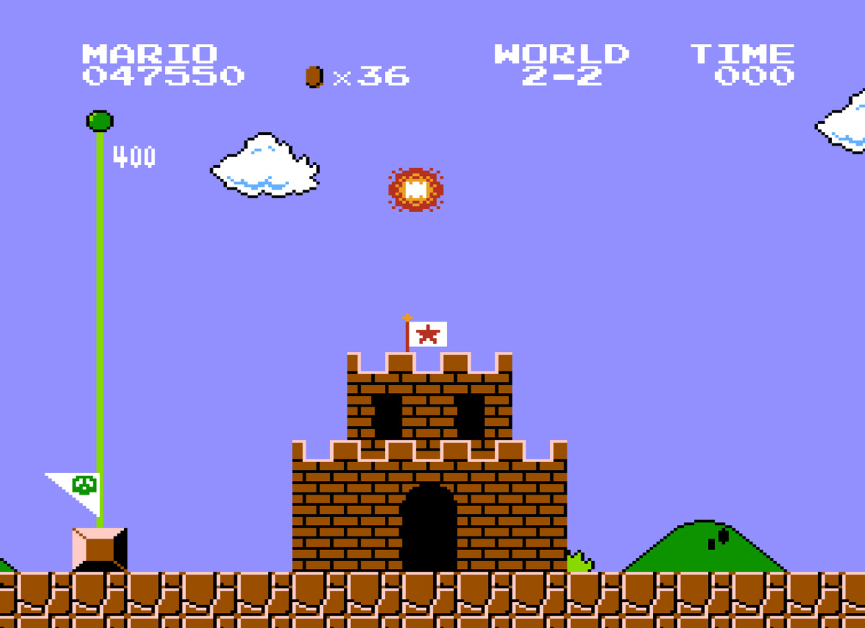
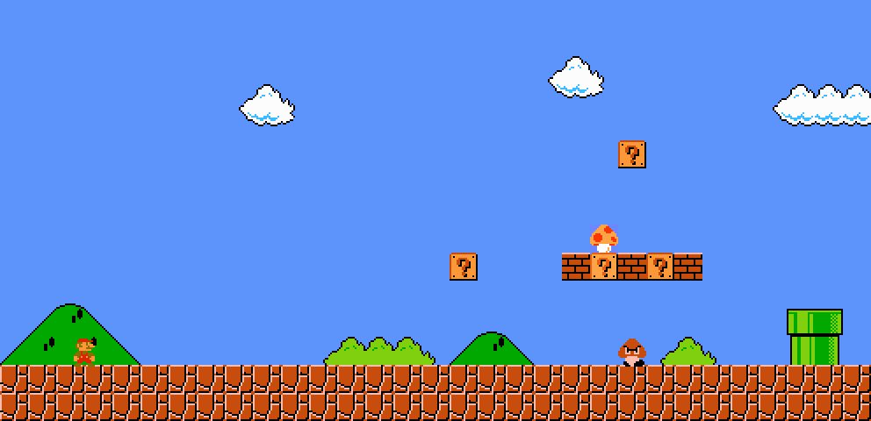
Background for SMB (Super Mario Bros.)
Game Aspect for Goal:
  Mario, Italian plumber
  Pass through worlds full of enemy and obstacles
  Rescue the princess
Theory Aspect for Goal:
  From a starting point
  Go through all decision making states (enemies or obstacles)
  Reaching a final point (flag or princess)

Slide 12
Statement Establishment for SMB
Theorem 3.1
It is NP-hard to decide whether the goal is reachable from the start of a stage in generalized Super Mario Bros.

Slide 13
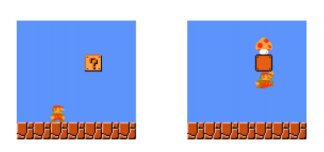
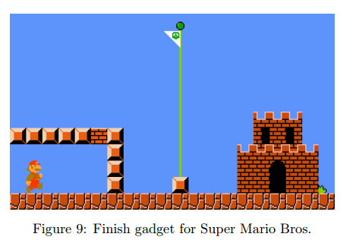
Construction for SMB (1)
Figure 8: Left: Start gadget for Super Mario Bros.
Right: The item block contains a Super Mushroom
Notes:
The Start and Finish gadgets are straightforward. The Start gadget, shown in Figure 8, includes an item block containing a Super Mushroom which makes Mario into Super Mario. The Super Mushroom serves two purposes. First, Super Mario is two tiles tall, which prevents him from fitting into narrow horizontal corridors, a property essential to our other gadgets. Second, Super Mario is able to destroy bricks whereas normal Mario cannot. In order to force the player to take the Super Mushroom in the beginning, we block Mario’s path with bricks in the Finish gadget

Slide 14
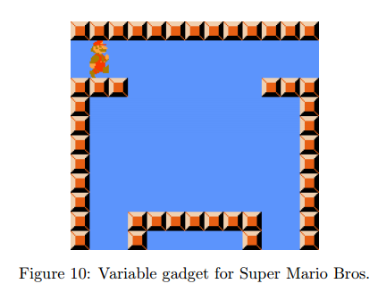
Construction for SMB (2)
Notes:
There are two entrances, one from each literal of the previous variable (if the variable is xi , the two entrances come from xi−1 and ¬xi−1). Once Mario falls down, he cannot jump back onto the ledges at the top, so Mario cannot go back to a previous variable. In particular, Mario cannot go back to the negation of the literal he chose. To choose which value to assign to the variable, Mario may fall down either the left passage or the right.

Slide 15
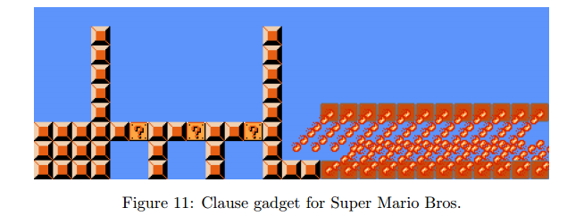
Construction for SMB (3)
Notes:
The three entrances at the bottom correspond to the three literals that are in the clause. The Clause is visited when Mario has been chosen the right path and went from the Variable Gate into this map and hit the item. When Mario is able to go from the left to the right for the final check, he would be able to get the stars. (the stars will bouncing in the middle area instead of vanishing). Without the stars, Mario cant travel though the fire area safely.

Slide 16
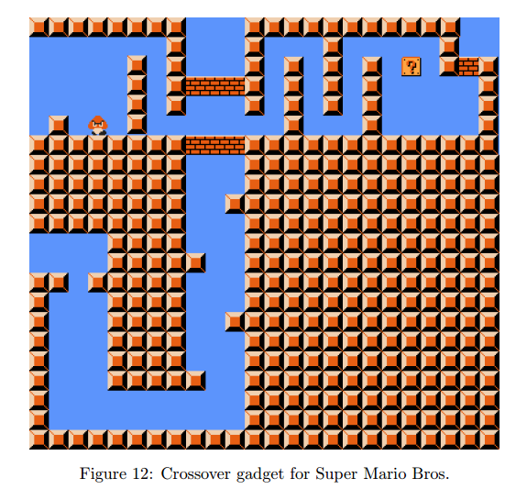
Construction for SMB (4)
Notes:
Left to Right: Path A
Bottom to Top: Path B
The Order:
first A, then B
Notes:
Approaching from the left:
Become small, then get mushroom to pass
Approaching from bottom:
Jump up and break the brick, and go upper side
Prevent leakage:
-- small Mario cant break brick
-- Big Mario cant go through the 1 tile area
-- Remark 2.2

Slide 17
Construction for SMB (Summary)
Notes:
Summarize the previous content

Slide 18

So, SMB is NP-Hard!
Hey, I am NP-Hard!

Slide 19
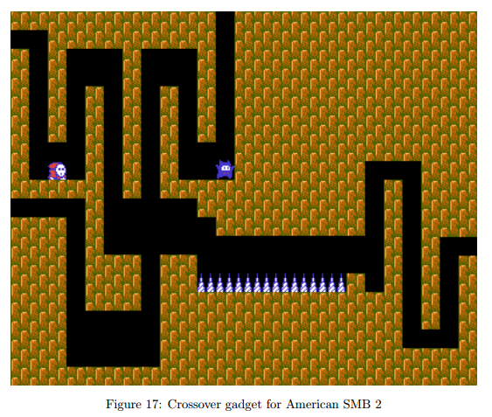
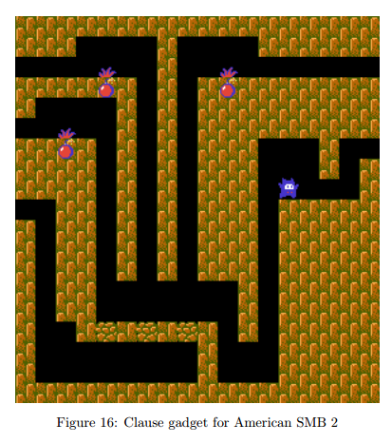
SMB alternatives on other series (SMB 2)

Slide 20
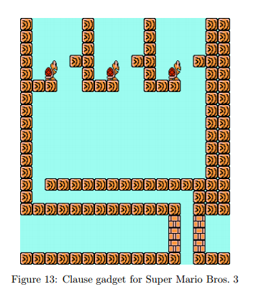
SMB alternatives on other series (SMB 3)

Slide 21
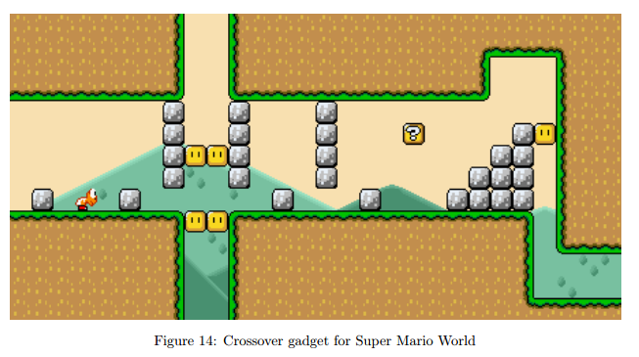
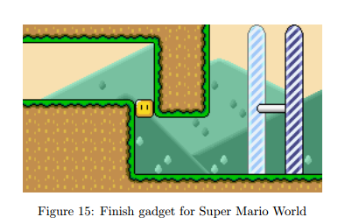
SMB alternatives on other series (SMB World)

Slide 22
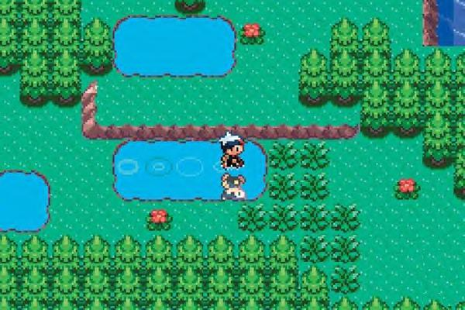
Proof for Pokemon
https://www.youtube.com/watch?v=sEUos3lcxro

Slide 23
Statement Establishment for Pokemon
Theorem 7.1
It is NP-hard to decide whether a given target location is reachable from a given start location in generalized Pokemon.
Theorem 7.2
It is NP-complete to decide whether a given target location is reachable from a given start location in generalized Pokemon in which the only overworld game elements are enemy Trainers.
Notes:
In this section, we give an alternate proof that Pok´emon is NP-hard using no elements of the game except enemy Trainers and the game’s battle mechanics (and thus no blocks). Therefore we obtain the following stronger result

Slide 24
Trainer Encounters Explanation
https://youtu.be/rK4N93TN7M8
4:30 start

Slide 25
Elements to Proof Pokemon
Wall: Blocking the way
Weak Trainer: Beating without losing life nor using item (Red)
Strong Trainer: Player always lose to this Trainer (Blue)
Notes:
In our implementations, we use three kinds of objects. Walls, represented by dark grey blocks, cannot be occupied or walked through. Trainers’ lines of sight are indicated by translucent rectangles. We have two types of Trainers. Weak Trainers, represented by red rectangles, are Trainers whom the player can defeat with certainty without expending any effort, i.e., without consuming 31 PP or taking damage. Strong Trainers, represented by blue rectangles, are Trainers against whom the player will always lose.

Slide 26
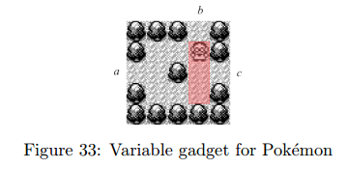
Construction for Pokemon (Variable Gadget)
Notes:
The Variable gadget, illustrated in Figure 33, must force the player to choose either an a-to-b traversal or an a-to-c traversal. We show that this is the case. The player enters through a. If the player wants to exit through b, they walk into the Trainer’s line of sight, luring the Trainer down and opening up the passage to b, but closing the passage to c. On the other hand, if the player wants to exit through c, they walk up to the Trainer and talk to him, disabling the Trainer, so that they may walk around and exit through c.

Slide 27
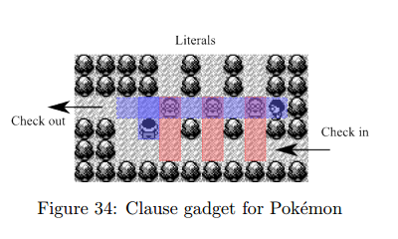
Construction for Pokemon (Clause Gadget)
Notes:
The Clause gadget, depicted in Figure 34, is unlocked whenever the player enters from one of the top paths and talks to one of the three weak Trainers, disabling him. When the Check path is traversed, every weak guard who has not been disabled is lured down by the player, thus getting out of the line of sight of the rightmost strong Trainer. Eventually the player must cross that line of sight, and is reached by the strong Trainer if and only if no weak Trainer blocks him, which happens if and only if the Clause gadget is still locked. The leftmost strong Trainer prevents leakage from the Check path to the literals, in case the leftmost weak Trainer has been lured down.

Slide 28
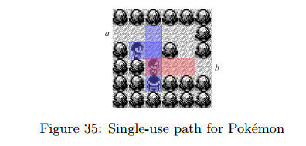
Introducing the Single-use Path
Notes:
we introduce the Single-use path, a path that can only be traversed once, and only in one direction. This is implemented by the gadget in Figure 35, which can be traversed only once, from a to b. Clearly, the player cannot enter via b, because that lures the weak Trainer to block the passage. Suppose the player enters through a. They can safely walk to b, because the weak Trainer is blocking the bottom strong Trainer’s line of sight. However, to reach b, the player must lure the weak Trainer out of the line of sight of the strong Trainer, hence 32 Figure 34: Clause gadget for Pok´emon the player may never return in the reverse direction. Also, there is a strong Trainer above the weak Trainer, preventing the player from disabling the weak Trainer by entering from a.

Slide 29
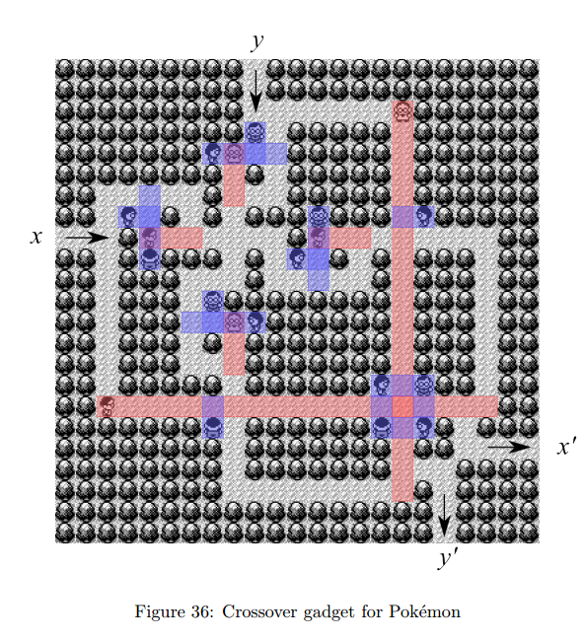
Construction for Pokemon (Crossover Gadget)
Notes:
Because the Crossover gadget is symmetric, we assume, without loss of generality, that the player attempts to traverse the x-to-x 0 passage first. Upon entering from x, they go down and disable the bottom weak Trainer, then go back up and proceed to the right. Observe that the top-left part of the gadget is a “crossroads” made of four isometric copies of the Single-use path of Figure 35. Upon reaching it, the player is forced to go either down or right. If they go down, they eventually get stuck, because the crossroads is now unreachable due to the just traversed Singe-use path, and the y 0 exit is unreachable too, because the top weak Trainer is lured all the way down to block the player, as soon as they attempt to exit. On the other hand, if the player proceeds to the right upon entering the crossroads, they can safely reach the x 0 exit, because the leftmost weak Trainer has been previously disabled. Note that, by doing so, the player incidentally crosses the line of sight of the top weak Trainer, luring him down and disabling him.
if the player wishes to traverse the y-to-y 0 passage, they must take the vertical Single-use paths of the crossroads, because the other two have already been traversed. At this point, the player has no choice but to exit from y 0 , which is safely reachable because the top weak Trainer has already been disabled during the first traversal of the gadget, and is not blocking the way out.

Slide 30
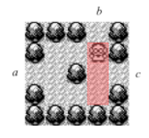

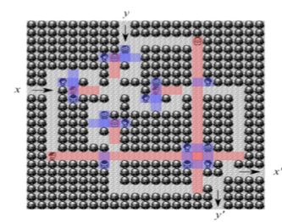
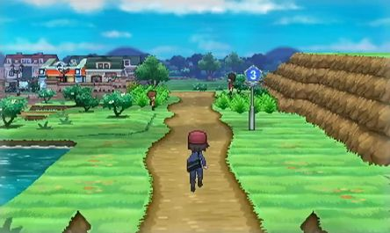
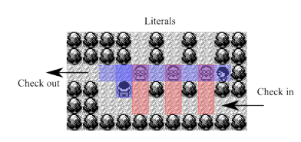
Construction for Pokemon (Summary)
Start
Exit

Slide 31

Hey, I am NP-Hard!
Me too!
Q & A Section

Slide 32
Extension Works
PSPACE-hardness proof for some extension series
  Using TQBF (True Quantified Boolean Formula) model to prove PSPACE-hardness
Dynamic Programming for the NP-hardness into P
EXPSPACE Model Establishments

Slide 33
References
MIT Review: Super Mario Bros Proved NP-Hard
https://www.technologyreview.com/s/427197/super-mario-bros-proved-np-hard/
Classic Nintendo Games are (Computationally) Hard by Giovanni Viglietta et al.
http://arxiv.org/pdf/1203.1895.pdf
International Conference on Fun with Algorithms
http://www2.idsia.ch/cms/fun16/
Math and Programming
https://jeremykun.com/2012/03/22/nintendo-np-hard/
Wiki: Game Complexity
https://en.wikipedia.org/wiki/Game_complexity
Gaming is a hard job, but someone has to do it! By GIOVANNI VIGLIETTA
http://arxiv.org/pdf/1201.4995v5.pdf

